Slide 1
GenAI Supersearch for MA- PoC
5/15/2024

Slide 2
Advancing HCP Engagement and Scientific Knowledge Exchange with Generative AI
Problem
Target Audience
Scope
Exit Criteria
Develop a Generative AI assisted Medical document search tool with Q&A capability to demonstrate technical feasibility and functional value
2-3 Users
Basic UI
Number documents : 46
Product considered: Pexidartinib
Tool provides relevant search results and summary of relevant sections of documents
Tool provides relevant citations
Decision on expanding PoC to Production application
MSLs relying on standard text search for locating vital documents/ information face challenges in terms of time and effort, leading to reduced productivity and effectiveness.
Field Medical teams
MSLs

Slide 3


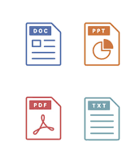





Solution Approach
1
2
3
4
Data Preparation
Index Relevant Data
Information Retrieval
LLM Inference
In ENLIVEN, how many patients experienced hepatotoxicity at 25 weeks
*
Relevant chunk of text data
Answer this question on the basis of context data received from the relevant chunks of text
Raw Files
Relevant chunk of text data
Document Repository
Relevant chunk of text data
Document Chunks
Response on the UI
*Not part of PoC

Slide 4
Key Benefits of using GenAI Supersearch
Rapid Summarization of Scientific Literature
Improved Medical Literature Review
Time Savings
Reduced Cognitive Load
Coherent Summaries

Slide 5
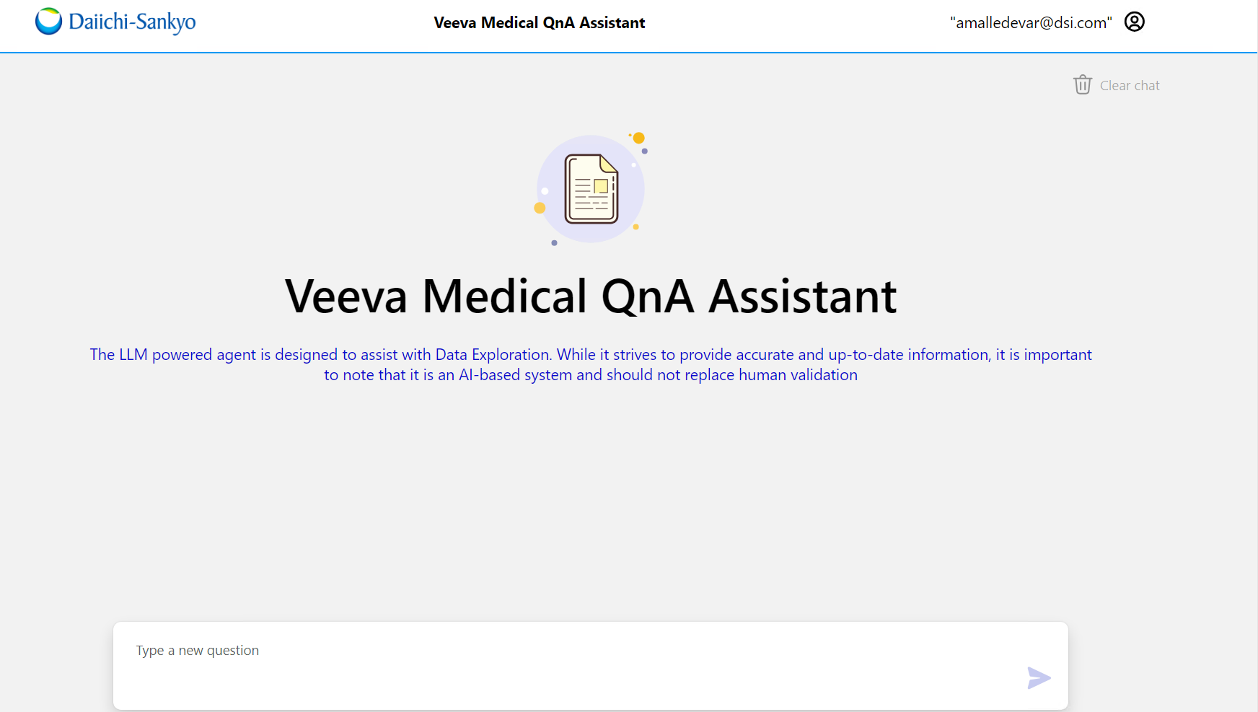
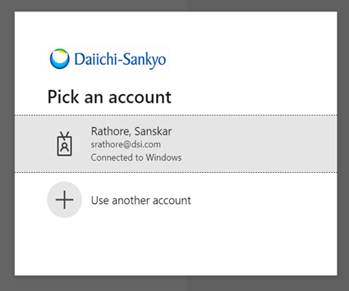
Accessing GenAI Supersearch PoC
1
2
3
Log into
https://dsi-assistant-dev.azurewebsites.net or https://dsi-assistant-uat.azurewebsites.net
To access the application, users must already be logged into the DSI environment, or they need to provide their DSI ID for authentication
The UI for Supersearch Assistant opens up. Fire away your queries!

Slide 6


Feedback from Pilot Users
“I think it is a very helpful tool. I see it being very useful in real time during KME meetings possibly.”
“The QnA seemed to work really well. I queried somewhere around 25-30 questions, and the system was able to return answers …”
“Impressive improvements to this tool.”

Slide 7
Feedback and Way Forward
Feedback | Next Steps*
The tool seems to favor certain document sources over others. | The responses generated by the tool are based on a vast dataset that includes a wide range of sources. To refine the search and summarization, the below approaches are recommended in the production implementation Enhanced Prompt engineering (Implemented this in PoC ) Source document categorization/tagging Context narrowing techniques including UI/UX
The tool has trouble identifying specifying endpoints based on data cutoffs | Enhanced Prompt engineering (Implemented this in PoC ) Business rule fine tunning
Tool favors picking responses from word docs over pdfs | The tool doesn't distinguish between Word documents and PDFs inherently. It processes text data uniformly, regardless of the file format. Enhanced Prompt engineering (Implemented this in PoC ) Business rule fine tunning
To include more than one Source for a response | A new approach has been implemented that allows for multiple sources to be included within the response.
Source/Citation did not show up as expected | With the new approach, the sources/citations are displayed as expected
* Some steps are currently not part of PoC scope

Slide 8
Next Steps to Operationalize
Data Sourcing and Integration
Document Repository Integration
Customize and Optimize
Search Optimization
UI Enhancements and Deployment
Stable State
Enhanced Prompt Engineering
Context Narrowing and Tagging
Operations Model
UI and UX design
Training End Users
Build Data sourcing Pipelines
Multi-Modal capabilities
Scalability and Performance
Navigation and asset tagging
Authentication: SSO Integration
Feedback mechanism
Data Security
Access Control (Product, Geography )
Integration with external sources(Ex: PubMed)
Model Monitoring and drift tracking
Business Rule fine tuning
Ability to save History
Long-term Memory
*Nice to have enhancements not impacting the function

Slide 9
Requirement Gathering
Which existing source systems does the AI assistant need to integrate with? Are there specific APIs we should consider for integration?
Which geographic region and brand should we initiate with?
Any specific category of documents we should consider as part of 1st iteration?
Approximately how many documents will be available and required for processing?
What types of documents (formats, sizes, etc.) need to be supported?
How should the system accommodate changes to documents, and how frequently will new documents be added, or existing documents updated?
User persona
How many users do we anticipate will use the assistant?
What specific roles should have access to the GenAI Supersearch, and what permissions should each role have?
What are the specific needs and expectations for the user interface to ensure it is intuitive and user-friendly?
System Requirements
User Requirements

Slide 10
Thank You
Do you have a question for us

Slide 11
APPENDIX: Key Benefits of using GenAI Supersearch
Improved efficiency
Improved efficiency and speed in searching and summarizing large volumes of medical literature and data.
Coherent Summaries
Ability to synthesize information from multiple sources into coherent summaries and reports. Generative AI can integrate findings from diverse studies and data sources into comprehensive overviews
Coverage
Pattern Detection
Identification of relevant studies and data that may have been missed in traditional searches due to the broad scope and language understanding capabilities of generative AI models
Potential to uncover novel connections and insights by analyzing patterns across large datasets that would be difficult for humans to discern
Automated Drafts
Automated generation of initial drafts of documents like literature reviews, which can then be refined and edited by human experts, streamlining the writing process.

